Slide 1
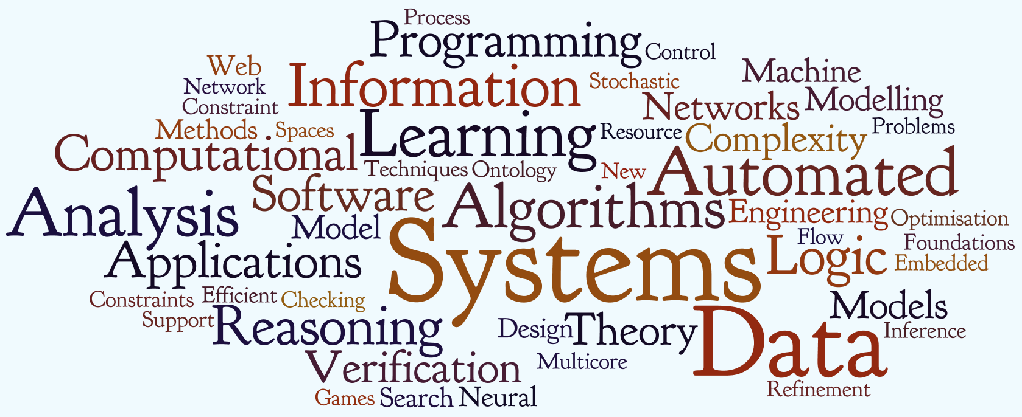
Subject : Computer Science
Subject Code : 083

Slide 2
Learning Objectives:
To understand basics of computers.
To develop logic for Problem Solving.
To develop problem solving skills and their implementation through using C++.
To understand and implement the concept of Object Oriented Methodology.
To understand the concept of working with Relational Database.
To understand the basic concept of Computing Logic.
To understand the basic concepts of Communication and Networking technologies.
To understand Open Source Software.

Slide 3
Class-XI Theory
Unit No. | Unit Name | Marks
1 | Computer fundamentals | 10
2 | Programming methodology | 12
3 | Introduction to c++ | 14
4 | Programming in c++ | 34
 | Total | 70

Slide 4
Class-XI Practical
Unit No. | Unit Name | Marks
1 | Programming in C++ | 10
2 | One logical problem to be solved through flow charts. | 04
3 | Project Work Problems using String, Number, Array and Structure manipulation | 06
4 | Practical File | 06
5 | Viva Voce | 04
 | Total | 30

Slide 5
Class-XII Theory
Unit No. | Unit Name | Marks
1 | Object oriented programming in C++ | 30
2 | Data structure | 14
3 | Database management system and Sql | 08
4 | Boolean algebra | 08
5 | Communication technologies | 10
Total |  | 70

Slide 6
Class-XII Practical
Unit No. | Unit Name | Marks
1 | Programming in C++ | 10
2 | SQL Commands | 05
3 | Project Work | 05
4 | Practical File | 06
5 | Viva Voce | 04
 | Total | 30

Slide 7
Central Board of Secondary Education
Computer Science (Theory) - Class XII Subject Code: 083
Design of Question Paper
Time : 3 hours Max. Marks: 70
Weightage of marks over different dimensions of the question paper shall be as follows:
A. Weightage to different topics/content units
S.No | Topics | Marks
1 | Review of C++ covered in Class XI | 12
2 | Object Oriented Programming in C++ | 12
3 | Data Structure & Pointers | 14
4 | Data File Handling in C++ | 06
5 | Databases and SQL | 10
6 | Boolean Algebra | 8
7 | Communication and Open Source Concepts | 8
 | Total | 70

Slide 8
B. Weightage to different forms of questions
S.No | Forms of Questions | Marks for each question | No. of Questions | Total Marks
1 | Very Short Answer questions (VSA) | 1 | 9 | 9
2 | Short answer questions – Type I (SA I) | 2 | 13 | 26
3 | Short answer questions – Type II (SA II) | 3 | 5 | 15
4 | Long answer questions (LA) | 4 | 5 | 20
 |  | Total | 32 | 70
C. Scheme of Options
There will be no overall choice. All questions are compulsory.
D. Difficulty level of questions
Based on the above design, two sets of sample papers along with their blue prints and Marking schemes have been included in this document.
About 20% weightage has been assigned to questions testing higher order thinking (HOT) skills of learners.

Slide 9
Sn | Unit |  | VSA | SA I | SAII | LA | Total
 |  |  | (1 Marks) | (2 Marks) | (3 Marks) | (4 Marks)
1 | Review of C++ covered in Class XI |  | 1 (1) | 8 (4) | 3 (1) |  | 12(6)
2 | Object Oriented Programming in C++
 | a) | Introduction to OOP using C++ |  | 2(1) |  | 4(1) | 6(2)
 | b) | Constructor & Destructor |  | 2(1) |  |  | 2(1)
 | c) | Inheritance |  |  |  | 4(1) | 4(1)
3 | Data Structure & Pointers
 | a) | Address Calculation |  |  | 3(1)
 | b) | Static Allocation of Objects |  | 2(1) | 3(1)
 | c) | Dynamic Allocation of Objects |  |  |  | 4(1)
 | d) | Infix & Postfix Expressions |  | 2(1)
4 | Data File Handling in C++
 | a) | Fundamentals of File Handling | 1(1) |  |  |  | 1(1)
 | b) | Text File |  | 2(2) |  |  | 2(1)
 |  | Binary Files |  |  | 3(1) |  | 3(1)
(continue…..)

Slide 10
Sn | Unit |  | VSA | SA I | SAII | LA | Total
 |  |  | (1 Marks) | (2 Marks) | (3 Marks) | (4 Marks)
5 | Databases and SQL
 | a) | Database Concepts |  | 2(1) |  |  | 2(1)
 | b) | Structured Query Language | 2(1) | 2(1) |  | 4(1) | 6(4)
6 | Boolean Algebra
 | a) | Introduction to Boolean Algebra & Laws |  | 2(1) |  |  | 2(1)
 | b) | SOP & POS | 1(1) |  |  |  | 1(1)
 | c) | Karnaugh Map |  |  | 3(1) |  | 3(1)
 | d) | Basic Logic Gates |  | 2(1)
7 | Communication & Open Source Concepts
 | a) | Introduction to Networking | 1(1) |  |  |  | 1(1)
 | b) | Media,Devices,Topologies & Protocols |  |  |  | 4(1) | 4(1)
 | c) | Security | 1(1) |  |  |  | 1(1)
 | d) | Webservers | 1(1) |  |  |  | 1(1)
 | e) | Open Source Terminologies | 1(1) |  |  |  | 1(1)
 |  |  | 9(1) | 26(13) | 15(5) | 20(5) | 70(32)

Slide 11
Class XII (Practical) - C++
Duration: 3 hours |  |  | Total Marks : 30
1 | Programming in C++ |  |  | 10
 | One programming problem in C++ to be developed and tested in Computer during the examination. Marks are allotted on the basis of following: Logic 6 Marks Documentation/Indentation 2 Marks Output presentation 2 Marks Notes: The types of problem to be given will be of application type from the following topics Arrays (One dimensional and two dimensional) Class(es) and objects Stack using arrays and or linked implementation Queue using arrays (circular) and or linked implementation Binary File operations (Creation, Displaying, Searching and modification) Text File operations (Creation, Displaying and modification)
2 | SQL Commands |  |  | 05
 | Five Query questions based on a particular Table / Relation to be tested practically on Computer during the examination. The command along with the result must be written in the answer sheet.

Slide 12
Class XII (Practical) - C++Continue…
3 | Project Work | 05
 | The project has to be developed in C++ language with Object Oriented Technology and also should have use of Data files. (The project is required to be developed in a group of 2-4 students) Presentation on the computer Project report (Listing, Sample, Outputs, Documentations) Viva * 1 mark is for innovation while writing programme.
4 | Practical File | 06
 | Must have minimum 20 programs from the following topics Arrays (One dimensional and two dimensional, sorting, searching, merging, deletion' a insertion of elements) Class(es) and objects Stacks using arrays and linked implementation Queue using arrays a linked implementation (circular aslo). File (Binary and Text) operations (Creation, Updation, Query) Any computational Based problems 15 SQL commands along with the output based on any table/relation:
5 | Viva Voce | 04
 | Viva will be asked from syllabus covered in class XII and the project developed by student.

Slide 13
Guidelines for Projects (Class XI and XII)
1. Preamble
1.1 The academic course in Computer Science includes on Project in each year. The Purpose behind this is to consolidate the concepts and practices imparted during the course and to serve as a record of competence.
1.2 A group of 2-3 students as team may be allowed to work on one project.
2. Project content
2.1 Project for class XI can be selected from the topics mentioned in the syllabus or domains on the similar lines
2.2 Project for class XII should ensure the coverage of following areas of curriculum:
Flow of control , Data Structure , Object Oriented Programming C++, Data File Handling , Theme of the project can be Any subsystem of a System Software or Tool Any Scientific or a fairly complex algorithmic situation School Management, Banking, Library Information System, Hotel or Hospital Management System, Transport query system , Quizzes / Games; Tutor, Computer Aided Learning Systems
2.3 It is suggested to prepare a bilingual (English and other Indian language) user manual part of project file.
2.4 The aim of the project is to highlight the abilities of algorithmic formulation, modular programming, optimized code preparation, systematic documentation and other associated aspects of Software Development.

Slide 14
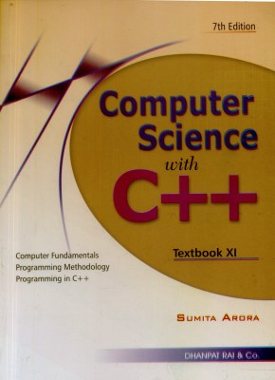
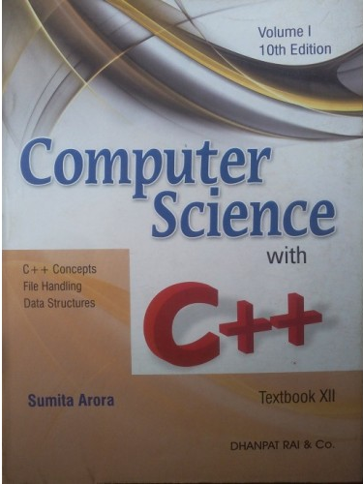
Textbook

Slide 15
